Slide 1
Unit-5 (Introduction To Forensic Science And Law)
Ashna Bhatia

Slide 2
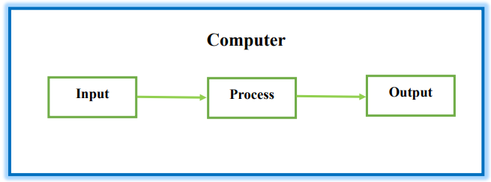
Computer and its Functionalities
Computer is an advanced electronic device that takes raw data as an input from the user and processes it under the control of a set of instructions (called program), produces a result (output), and saves it for future use. This tutorial explains the foundational concepts of computer hardware, software, operating systems, peripherals, etc. along with how to get the most value and impact from computer technology.
There are three basic functionalities of a Computer System and they are
Input
Process
Output
But if we look at it in a very broad sense, any digital computer carries out the following five functions:
Step 1 - Takes data as input.
Step 2 - Stores the data/instructions in its memory and uses them as required.
Step 3 - Processes the data and converts it into useful information.
Step 4 - Generates the output.
Step 5 - Controls all the above four steps.

Slide 3
ADVANTAGES OF COMPUTER
High Speed
Computer is a very fast device.
It is capable of performing calculation of very large amount of data.
The computer has units of speed in microsecond, nanosecond, and even the picosecond.
It can perform millions of calculations in a few seconds as compared to man who will spend many months to perform the same task.
Accuracy
In addition to being very fast, computers are very accurate.
The calculations are 100% error free.
Computers perform all jobs with 100% accuracy provided that the input is correct.

Slide 4
ADVANTAGES OF COMPUTER
Storage Capability
Memory is a very important characteristic of computers.
A computer has much more storage capacity than human beings.
It can store large amount of data.
It can store any type of data such as images, videos, text, audio, etc.
Diligence
Unlike human beings, a computer is free from monotony, tiredness, and lack of concentration.
It can work continuously without any error and boredom.
It can perform repeated tasks with the same speed and accuracy.

Slide 5
ADVANTAGES OF COMPUTER
Versatility
A computer is a very versatile machine.
A computer is very flexible in performing the jobs to be done.
This machine can be used to solve the problems related to various fields.
At one instance, it may be solving a complex scientific problem and the very next moment it may be playing a card game.
Reliability
A computer is a reliable machine.
Modern electronic components have long lives.
Computers are designed to make maintenance easy.

Slide 6
ADVANTAGES OF COMPUTER
Automation
Computer is an automatic machine.
Automation is the ability to perform a given task automatically. Once the computer receives a program i.e., the program is stored in the computer memory, then the program and instruction can control the program execution without human interaction.
Reduction in Paper Work and Cost
The use of computers for data processing in an organization leads to reduction in paperwork and results in speeding up the process.
As data in electronic files can be retrieved as and when required, the problem of maintenance of large number of paper files gets reduced.
Though the initial investment for installing a computer is high, it substantially reduces the cost of each of its transaction.

Slide 7
disadvantages OF COMPUTER
No I.Q.
A computer is a machine that has no intelligence to perform any task.
Each instruction has to be given to the computer.
A computer cannot take any decision on its own.
Dependency
It functions as per the user’s instruction, thus it is fully dependent on humans.
Environment
The operating environment of the computer should be dust free and suitable.
No Feeling
Computers have no feelings or emotions.
It cannot make judgment based on feeling, taste, experience, and knowledge unlike humans.

Slide 8
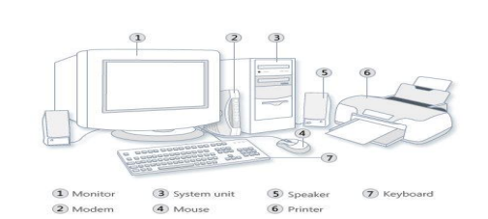
Components of a Computer
Computers consists of HARDWARE AND SOFTWARE.
Hardware:
Computer hardware is the collection of physical elements that constitutes a computer system. Computer hardware refers to the physical parts or components of a computer such as the monitor, mouse, keyboard, computer data storage, hard drive disk (HDD), system unit (graphic cards, sound cards, memory, motherboard and chips), etc. all of which are physical objects that can be touched.

Slide 9
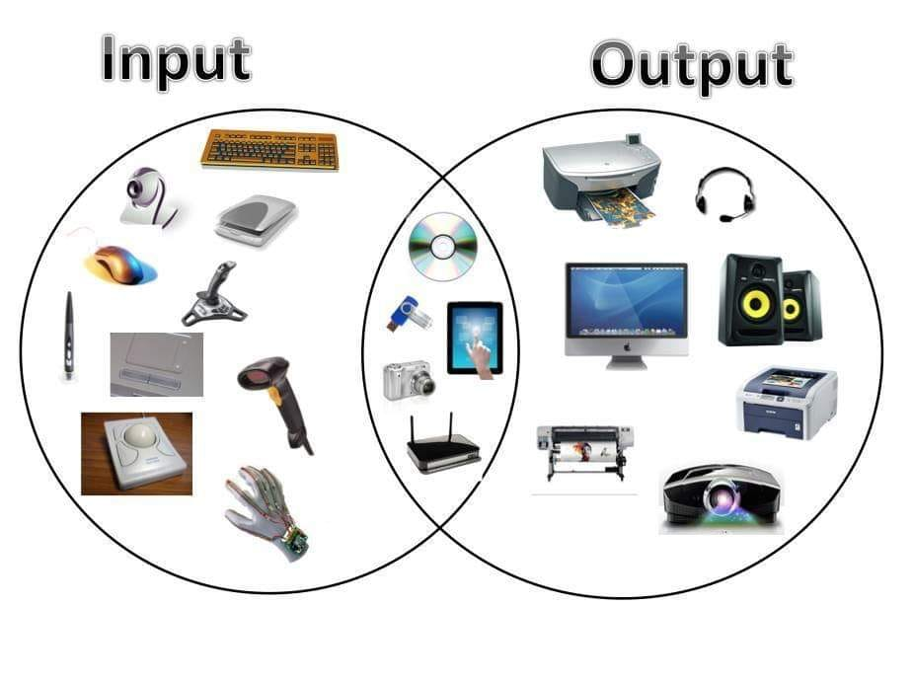
Input Devices and Output devices
Continued….

Slide 10
Continued….
Input Devices:
Input device is any peripheral (piece of computer hardware equipment to provide data and control signals to an information processing system such as a computer or other information appliance. Input device Translate data from form that humans understand to one that the computer can work with. Most common are keyboard and mouse.
Examples of Input Devices –
Keyboard | Graphic Tablets | Electronic Whiteboard
Mouse (Pointing Device) | Cameras | Remote Control
Microphone | Pen Input | Digital Camera
Touch Screen | Video Capture Hardware | Light Pens
Scanner | Trackballs | Joystick
Webcam | Barcode Reader | Gamepad
Touchpads | MIDI Keyboard
Note: The most common use keyboard is the QWERTY keyboard. Generally standard Keyboard has 104 keys.

Slide 11
Continued….
Output Devices:
An output device is any piece of computer hardware equipment used to communicate the results of data processing carried out by an information processing system (such as a computer) which converts the electronically generated information into human readable form.
Examples of Input Devices –
Monitor | LCD Projection Panels | Printers (All Types)
Computer Output Microfilm (COM) | Plotters | Speakers
Projector
Note:
Basic types of monitors are:
Cathode Ray Tube (CRT)
Liquid Crystal Displays (LCD)
Light-emitting diode (LED)
Printer types:
Laser Printer
Ink Jet Printer
Dot Matrix Printer

Slide 12
Continued….
Central Processing Unit (CPU):
A CPU is brain of a computer. It is responsible for all functions and processes. Regarding computing power, the CPU is the most important element of a computer system.
The CPU is comprised of three main parts :
Arithmetic Logic Unit (ALU): Executes all arithmetic and logical operations. Arithmetic calculations like as addition, subtraction, multiplication and division. Logical operation like compare numbers, letters, or special characters.
Control Unit (CU): controls and co-ordinates computer components.
Read the code for the next instruction to be executed.
Increment the program counter so it points to the next instruction.
Read whatever data the instruction requires from cells in memory.
Provide the necessary data to an ALU or register.
If the instruction requires an ALU or specialized hardware to complete, instruct the hardware to perform the requested operation.
Registers: Stores the data that is to be executed next, “very fast storage area”.

Slide 13
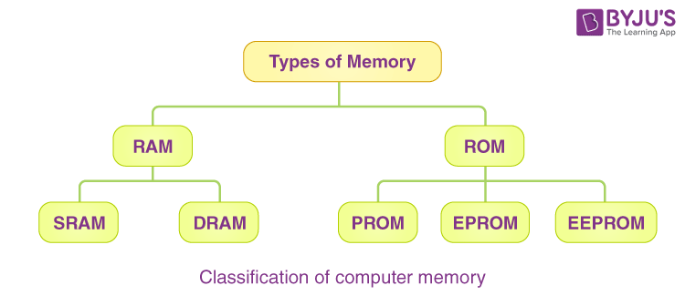
Continued….
Primary Memory:
RAM (Random Access Memory): RAM is a memory scheme within the computer system responsible for storing data on a temporary basis, so that it can be promptly accessed by the processor as and when needed. It is volatile in nature, which means that data will be erased once supply to the storage device is turned off. RAM stores data randomly and the processor accesses these data randomly from the RAM storage. RAM is considered “random access“ because you can access any memory cell directly if you know the row and column that intersect at that cell.

Slide 14
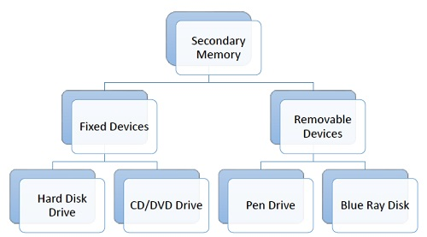
Continued….
Secondary Memory:
Stores data and programs permanently: its retained after the power is turned off.
Hard drive (HDD):A hard disk is part of a unit, often called a “disk drive,” “hard drive,” or “hard disk drive,” that store and provides relatively quick access to large amounts of data on an electromagnetically charged surface or set of surfaces.
ROM (Read Only Memory): ROM is a permanent form of storage. ROM stays active regardless of whether power supply to it is turned on or off. ROM devices do not allow data stored on them to be modified.
Optical Disk (ODD): is a disk drive that uses laser light as part of the process of reading or writing data to or from optical discs. Some drives can only read from discs, but recent drives are commonly both readers and recorders, also called burners or writers. Compact discs, DVDs, and Bluray discs are common types of optical media which can be read and recorded by such drives. Optical drive is the generic name; drives are usually described as “CD”, “DVD”, or “Bluray”, followed by “drive”, “writer”, etc. There are three main types of optical media: CD, DVD, and Blu-ray disc. CDs can store up to 700 megabytes (MB) of data and DVDs can store up to 8.4 GB of data. Blu-ray discs, which are the newest type of optical media, can store up to 50 GB of data. This storage capacity is a clear advantage over the floppy disk storage media (a magnetic media), which only has a capacity of 1.44 MB.
Flash Disk: A storage module made of flash memory chips. A Flash disks have no mechanical platters or access arms, but the term “disk” is used because the data are accessed as if they were on a hard drive. The disk storage structure is emulated.

Slide 15
Continued….
Comparison between Main Memory (RAM) and Secondary Memory (Hard Disk)
RAM | Hard Disk (Hard Drive)
Memory | Storage
Smaller amount (typically 500 MB to 6 GB) | Much larger amount (typically 80 GB to 1000 GB)
Temporary storage of files and programs | Permanent storage of files and programs
A little like your real desktop – has only your current work on it | Like a file cabinet – has long term storage of work
Contents disappear when you turn off power to the computer and when the computer crashes | Contents remain when you turn off the power to the computer (they don’t disappear unless you purposely delete them), and when the computer crashes.
Consists of chips (Microprocessors) | Consists of hard disks (platters)
When you want to use a program, a temporary copy is put into RAM and that’s the copy you use | Hold the original copy of the program permanently

Slide 16
Continued….
Software
Software is a generic term for organized collections of computer data and instructions, often broken into two major categories: system software that provides the basic non task-specific functions of the computer, and application software which is used by users to accomplish specific tasks.
Software Types
System software is responsible for controlling, integrating, and managing the individual hardware components of a computer system so that other software and the users of the system see it as a functional unit without having to be concerned with the low-level details such as transferring data from memory to disk, or rendering text onto a display. Generally, system software consists of an operating system and some fundamental utilities such as disk formatters, file managers, display managers, text editors, user authentication (login) and management tools, and networking and device control software.
Application software is used to accomplish specific tasks other than just running the computer system. Application software may consist of a single program, such as an image viewer; a small collection of programs (often called a software package) that work closely together to accomplish a task, such as a spreadsheet or text processing system; a larger collection (often called a software suite) of related but independent programs and packages that have a common user interface or shared data format, such as Microsoft Office, which consists of closely integrated word processor, spreadsheet, database, etc.; or a software system, such as a database management system, which is a collection of fundamental programs that may provide some service to a variety of other independent applications.

Slide 17
Continued….
Comparison between Application Software and System Software
Basis | System Software | Application Software
Definition | Computer software, or just software is a general term primarily used for digitally stored data such as computer programs and other kinds of information read and written by computers. App comes under computer software though it has a wide scope now. | Application software, also known as an application or an “app”, is computer software designed to help the user to perform specific tasks.
Example | 1) Microsoft Windows 2) Linux 3) Unix 4) Mac OSX 5) DOS | 1) Opera (Web Browser) 2) Microsoft Word (Word Processing) 3) Microsoft Excel (Spreadsheet software) 4) MySQL (Database Software) 5) Microsoft PowerPoint (Presentation Software) 6) Adobe Photoshop (Graphics Software)
Interaction | Generally, users do not interact with system software as it works in the background | Users always interact with application software while doing different activities
Dependency | System software can run independently of the application software | System software can run independently of the application software

Slide 18
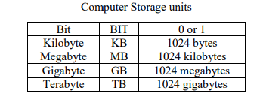
Continued….
Unit of Measurements
Storage measurements: The basic unit used in computer data storage is called a bit (binary digit). Computers use these little bits, which are composed of ones and zeros, to do things and talk to other computers. All your files, for instance, are kept in the computer as binary files and translated into words and pictures by the software (which is also ones and zeros). This two number system, is called a “binary number system” since it has only two numbers in it. The decimal number system in contrast has ten unique digits, zero through nine.
Size example:
1 bit - answer to an yes/no question
1 byte - a number from 0 to 255.
90 bytes: enough to store a typical line of text from a book.
4 KB: about one page of text.
120 KB: the text of a typical pocket book.
3 MB - a three minute song (128k bitrate)
650-900 MB - an CD-ROM
1 GB -114 minutes of uncompressed CD-quality audio at 1.4 Mbit/s
8-16 GB - size of a normal flash drive

Slide 19
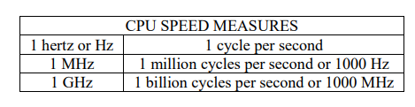
Continued….
Unit of Measurements
Speed measurement: The speed of Central Processing Unit (CPU) is measured by Hertz (Hz), Which represent a CPU cycle. The speed of CPU is known as Computer Speed.

Slide 20
Generations of computer
Generation in computer terminology is a change in technology a computer is/was being used. Initially, the generation term was used to distinguish between varying hardware technologies. Nowadays, generation includes both hardware and software, which together make up an entire computer system.
There are five computer generations known till date. Each generation has been discussed in detail along with their time period and characteristics. In the following table, approximate dates against each generation has been mentioned, which are normally accepted.
Following are the main five generations of computers.
Sl. No. | Generation & Description
1 | First Generation The period of first generation: 1946-1959. Vacuum tube based.
2 | Second Generation The period of second generation: 1959-1965. Transistor based.
3 | Third Generation The period of third generation: 1965-1971. Integrated Circuit based.
4 | Fourth Generation The period of fourth generation: 1971-1980. VLSI microprocessor based.
5 | Fifth Generation The period of fifth generation: 1980-onwards. ULSI microprocessor based

Slide 21
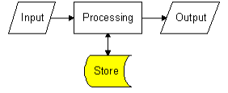
Different types of storage media
All information systems need to store data. This may be done temporarily whilst inputs are processed to produce outputs or for much longer periods of time.
A storage device stores programs and data either temporarily or permanently. All information systems contain two different types of storage :
Immediate Access Store (IAS): Immediate access store holds programs and data that the user is currently working with. Immediate access store is also known as main store or primary store( RAM).
Backing Store: Backing store keeps data and programs when the computer is turned off. Backing store is also known as secondary store.

Slide 22
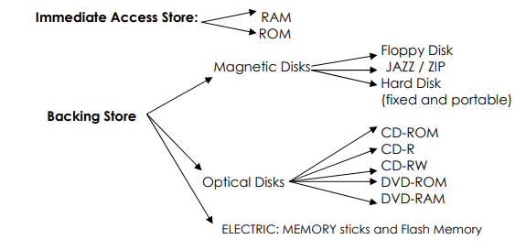
Different types of storage media
Continued….

Slide 23
Category to cyber crime
Cyber Crime can be deﬁned as unlawful acts committed by using the computer as a tool or as a target or as both.
Cyber crimes can involve criminal activities that are traditional in nature, such as theft, fraud, forgery (copy), defamation (insult) and mischief, all of which are subject to the Indian Penal Code.
The abuse of computers has also given birth to a gamut (range) of new age crimes that are addressed by the Information Technology Act, 2000 (introduced on 17th Oct 2000).
Cyber crime can be categorized mainly in two ways:
Using the Computer as a Target: Using a computer to at-tack other computers. E.g. Hacking, Virus/Worm attacks, DOS attack etc.
Using the computer as a Weapon: Using a computer to commit real world crimes. E.g. Cyber Terrorism, IPR violations, Credit card frauds, EFT frauds, Pornography etc.

Slide 24
Moreover we further categorized as follows:
Unauthorized Access
Hacking & Cracking
Cyber Fraud/Online Fraud (Spoof Websites and Email Security Alerts, Virus Hoax Emails, Lottery Frauds, Spoofing, Credit Card Fraud)
Cyber Theft (Identity Theft, Theft of Internet Hours, Theft of Computer System (Hardware)
Cyber Terrorism
Cyber Pornography
Defamation
Cyber Stalking
Email & IRC Related Crimes (Email Spoofing, Email Spamming, Email Bombing, Sending Threatening Emails, Defamatory Emails, Email Frauds, Internet Relay Chat (IRC) Related)
Spamming
Denial of Service Attacks
Forgery
IPR Violations
E-Commerce/Investment Frauds
Sale of illegal articles
Online Gambling
Data diddling
Physically Damaging a Computer System
Breach of Privacy and Confidentiality
Continued….

Slide 25
Cyber law (refer the notes for the topic provided to you and read only from the topics mentioned below)
History of Internet and World Wide Web
Cyber crime on the rise
Important terms related to cyber law
Cyber Law in India: In India, cyber laws are contained in the Information Technology Act, 2000 ("IT Act") which came into force on October 17, 2000. The main purpose of the Act is to provide legal recognition to electronic commerce and to facilitate filing of electronic records with the Government.
The following Act, Rules and Regulations are covered under cyber laws:
Information Technology Act, 2000
Information Technology (Certifying Authorities) Rules, 2000
Information Technology (Security Procedure) Rules, 2004
Information Technology (Certifying Authority) Regulations, 2001
Need for cyber law in India
History of cyber law in India
Information Technology Act, 2000
Overview of other laws amended by the IT Act, 2000
Overview Of The Information Technology Act, 2000
Cyber Crimes/Cyber Frauds

Slide 26
Cyber ethics
Cyberethics is a branch of computer technology behavior that defines the best practices that must be adopted by a user when he uses the computer system.
In simple terms, cyberethics refers to the basic ethics and etiquette that must be followed while using a computer system.
Ethics, in general, refers to propagating good behavior, similarly by cyber ethics we refer to propagating good behavior online that is not harsh or rude.
Cyberethics governs rules that individuals must be polite and responsible when they use the internet.
Cyberethics aim to protect the moral, financial, social behavior of individuals.
Cyberethics engages the users to use the internet safely and use technology responsibly and sensibly.
Cyberethics empathizes the behavior that must be adopted while using cyber technology.

Slide 27
Continued….
Some of the breaches of cyberethics are listed below:
Cyber Bullying: Cyberbullying is a form of bullying carried out via internet technology such as social media where individuals are mocked on their physical appearance, lifestyle, preferences, etc. The teenage generation or say youngsters are the major victims of this form of cyber ethic breach. Cyberbullying affects the emotional ethics of individuals and can cause mental disturbance to individuals.
Hacking: Stealing a user’s personal or organizational information without authorized permission is not considered a good practice. It is one of the riskiest cyber breaches to data leak. Data leak includes passing of sensitive information such as passwords, bank details of the user to a third-party user who is not authorized to access the information.
Copywriting: Claiming of another individual as one’s own is another type of cyber ethic breach that must be eradicated. Never engage in copywriting another person’s content or document and claim as it is your own. It leads to a serious problem called plagiarism, which is a punishable offense and considered a legal crime. It is always advisable to follow general cyberethics, while using the internet or say any kind of technology. A proper code of conduct must be followed while using cyber technology. Cyberethics if not used wisely can lead to serious situations. Social and legal laws are defined to use cyber technology wisely. In extreme cases, legal action can be taken if there is a violation of cyber ethics.

Slide 28
Continued….
Cyber Ethics focuses on the following:
1. Privacy:
The content that is available on the internet should not hurt any moral, emotional, or personal ethics of individuals.
Users should have the right to protect any information which they don’t want to share openly.
Private information like user’s contact details, address, security-related information like bank details, credit card/debit card details, are all included in basic cyber ethics of user privacy and must not be breached in any case.
Any breach of privacy is theft/fraud of user identity and user personal information, which is punishable as per the rules of law.
2. IPR:
IPR stands for Intellectual Property Rights.
IPR defines that the owners have the complete right to the content that is posted on the internet.
The entire content is solely a belonging of the originator and no individual is allowed to claim that content published by the original creator as its own.
Unauthorized distribution of someone else’s work should never be adopted as it’s ethically incorrect to not give creation and monetary benefits to the creator of the work.

Slide 29
Continued….
3. Security:
Security on the internet is the most basic ethical right that every user must be accessible.
Users of the internet should feel safe while they surf the net.
Security, in general means only authorized users to have access to the content on the computer.
And confidential information is safe, without any risk of loss of information/content.
4. Accuracy:
The content available on the internet is accessed by billions of users.
If there is no reliability of the information that is posted online, then it would mislead the masses.
Cyberethics assert the importance of posting content on the internet that is correct in all aspects.
Users trust the content of the internet and rely heavily on the internet for facts, therefore it is highly needed that the asked information is correct and reliable.

Slide 30
Continued….
Best policies that individuals must adopt while using the internet or any kind of technology should include the following:
Being Polite and not using harsh words.
Avoid clicking on unknown links.
Wisely opening Emails from known senders only.
Not mocking anyone on Social Media.
Not copying any individual’s work and claiming it as their own. Always cite that you have used someone else’s work.
Be careful and research before installing any free software.
Never intrude on another person’s privacy.
Don’t contribute to any malpractice that can lead to the leak of data of an individual or organization.
Never engage in Cyberbullying.
Never compromise with the safety of your system. Always install an anti-virus on your system.

Slide 31
Child sexual abuse material related to cyber domain
United States federal law defines child pornography as any visual depiction of sexually explicit conduct involving a minor (a person less than 18 years old). Outside of the legal system, NCMEC chooses to refer to these images as Child Sexual Abuse Material (CSAM) to most accurately reflect what is depicted – the sexual abuse and exploitation of children. Not only do these images and videos document victims’ exploitation and abuse, but when these files are shared across the internet, child victims suffer re-victimization each time the image of their sexual abuse is viewed. In a recent survey led by the Canadian Centre for Child Protection, 67% of CSAM survivors said the distribution of their images impacts them differently than the hands-on abuse they suffered because the distribution never ends and the images are permanent.
It’s important to remember CSAM consists of much more than just images and video files. While CSAM is seen and transmitted on computers and through other technology, these images and videos depict actual crimes being committed against children. The human element, children at risk, must always be considered when talking about this offense that is based in a high-tech world.
The disturbing reality is that the internet platforms we use every day to connect with each other and share information, including social media, online gaming, and e-mail, are now being used to disseminate and collect CSAM. CSAM can be found in virtually any online realm.
Notes:
Refer to this link as well ------ https://www.civilsdaily.com/news/child/

Slide 32
Continued….
Who are the Victims?
While there is limited research regarding victims of child sexual abuse material, it is a growing field of research and study to better understand the child victims and the offenders.
In March 2018, two studies on this topic were released. The first study is Production and Active Trading of Child Sexual Exploitation Images Depicting Identified Victims, which is based on data collected by NCMEC’s Child Victim Identification Program through 2014. The second study is Towards a Global Indicator on Unidentified Victims in Child Sexual Exploitation Material5, which is based on data in Interpol’s global system.
Below are key findings from these two studies:
Girls appear in the overwhelming majority of CSAM.1
Prepubescent children are at the greatest risk to be depicted in CSAM.2
When boys are victimized, they are much more likely than girls to be subjected to very explicit or egregious abuse.
On average boys depicted in CSAM are younger than girls and more likely to have not yet reached puberty.3
78% of reports regarding online enticement4 involved girls and 15% involved boys (in 8% of reports, the gender of the child could not be determined).

Slide 33
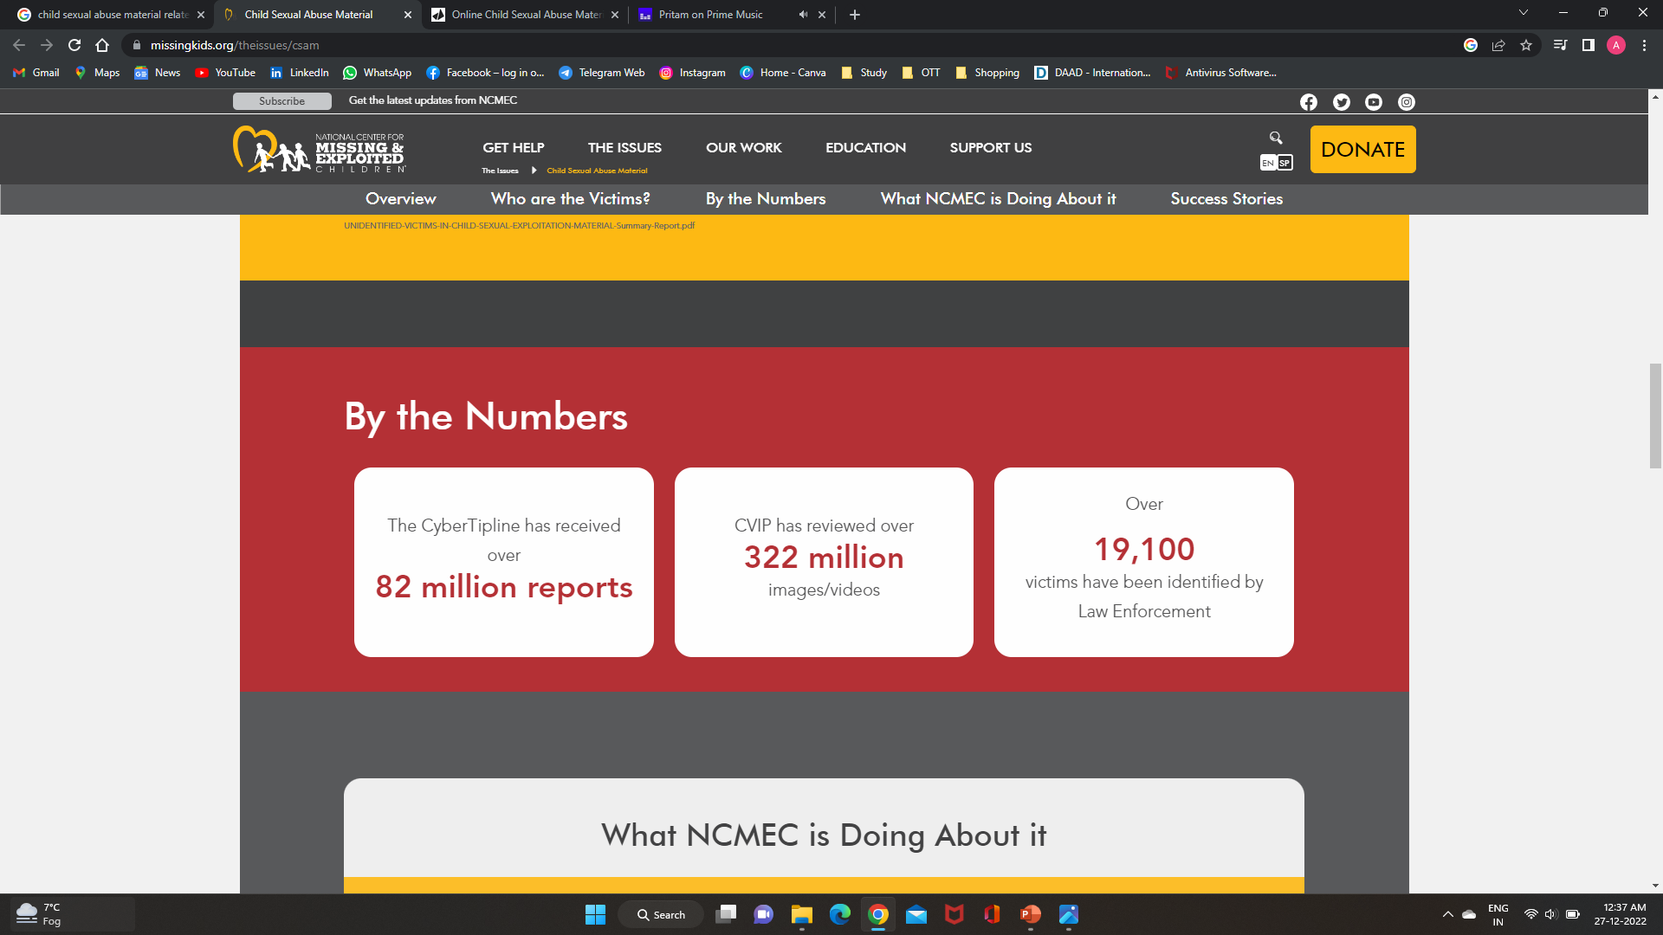
Continued….

Slide 34
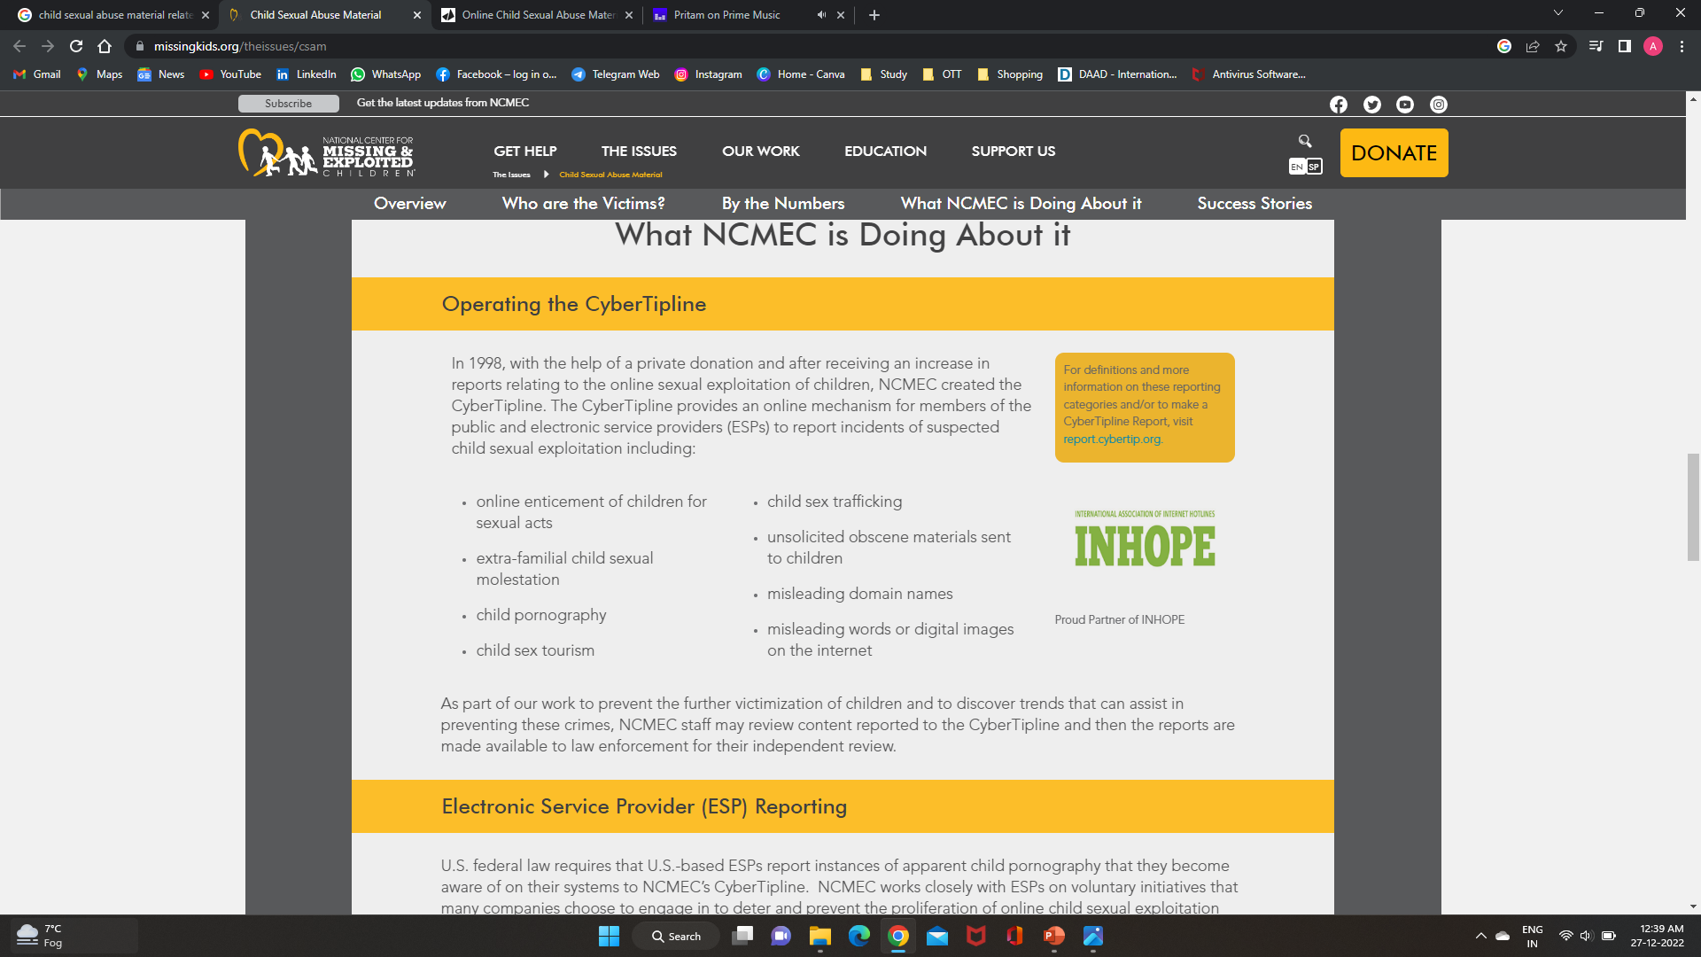
What NCMEC is Doing About it?
Continued….

Slide 35
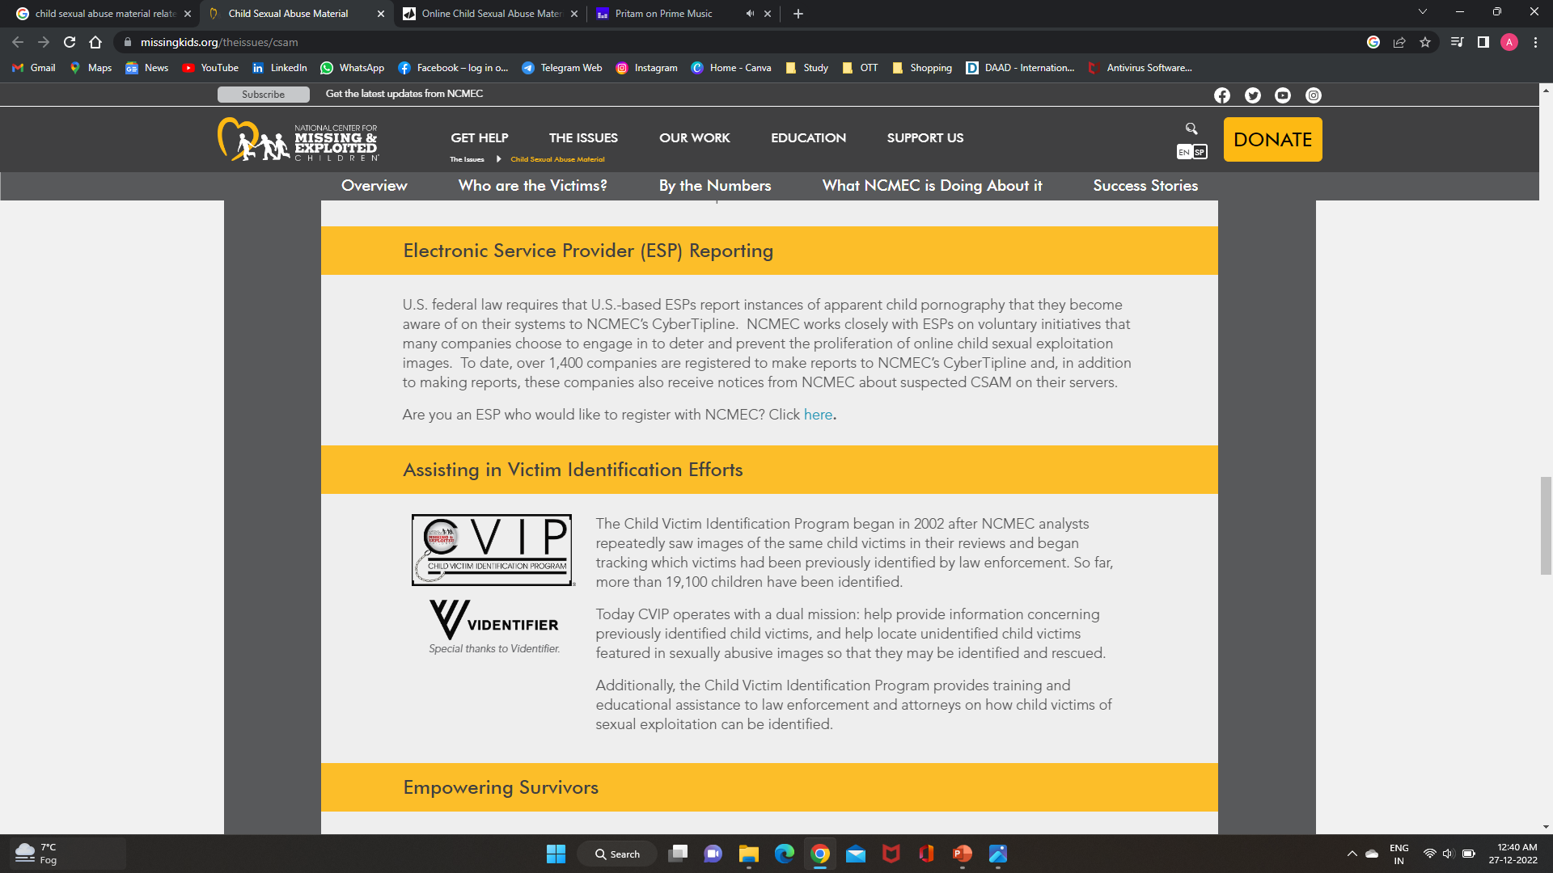
What NCMEC is Doing About it?
Continued….

Slide 36
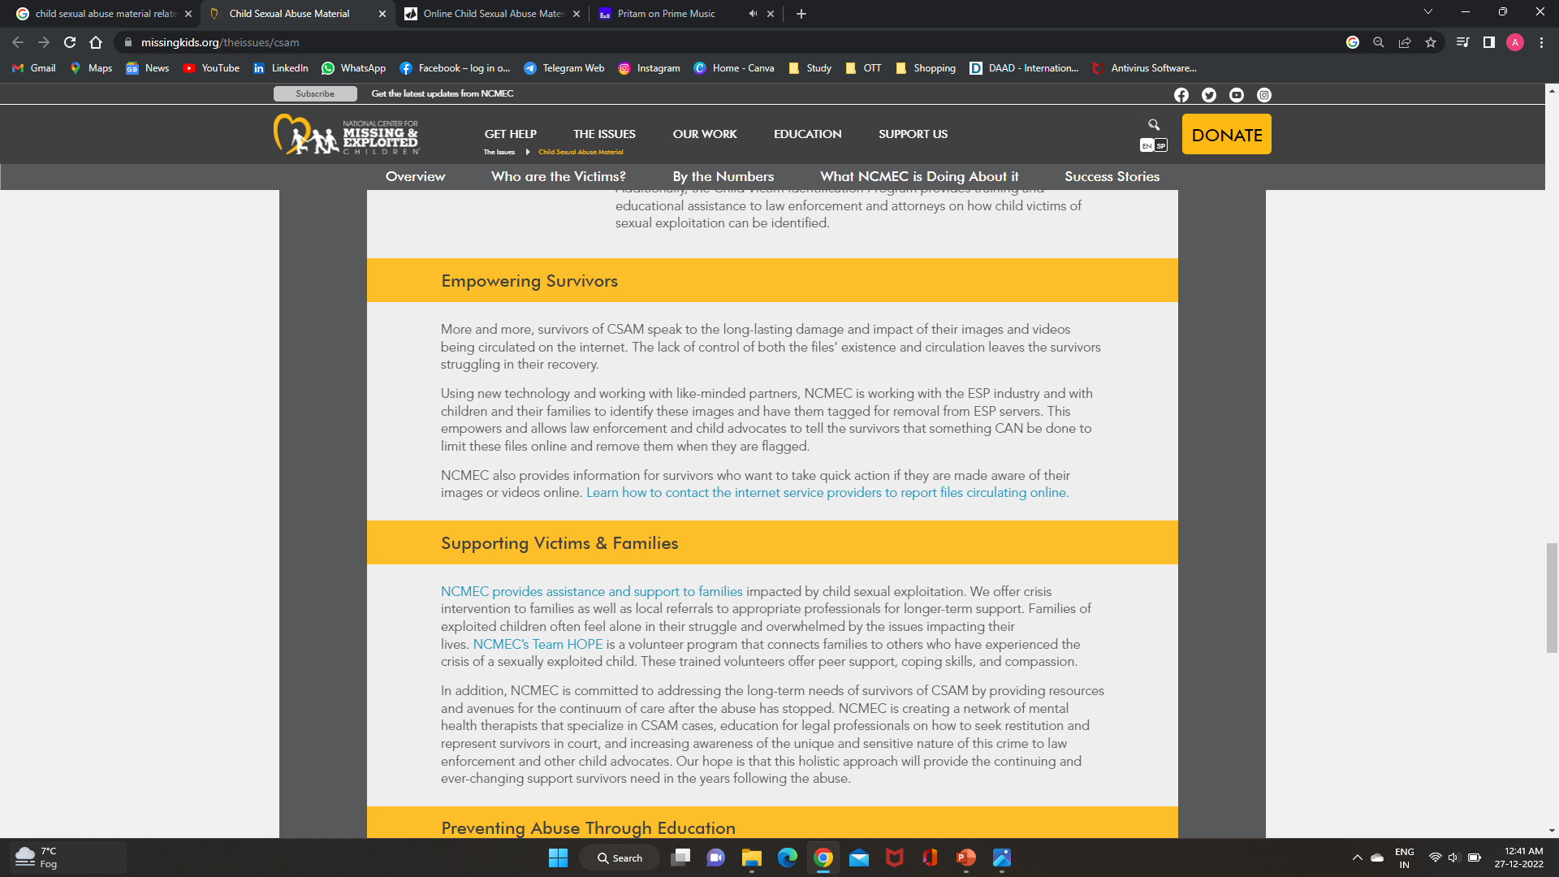
What NCMEC is Doing About it?
Continued….

Slide 37
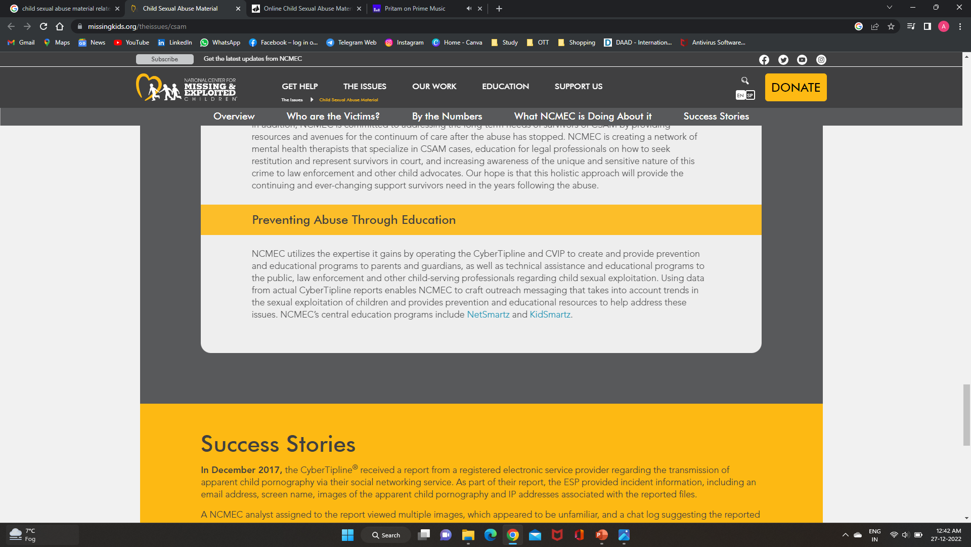
What NCMEC is Doing About it?
Continued….

Slide 38
Various laws related to social media
What is Social Media?
The term social in regards to media suggests that platforms are user oriented and becomes a place for communal activity. As such, social media can be viewed as online facilitators or enhancers of human network webs of individuals who enhance social connectivity. Social media largely consists of tools for sharing and exchanging information that is based on the internet and mobile devices. It combines technology, communications, and social interaction and offers a platform for exchanging ideas through written words, images, moving visuals, and musical compositions. People from all age groups are attracted to social media, especially the youth since it gives a medium for them to express their thoughts and discuss issues.
There are different types of social media such as social networking sites like Facebook, Instagram, Twitter, etc. Blogs, Vlogs, Social news, etc. all these options just make it easily accessible to people.
There are many benefits of using social media such as it helps in staying updated in current times, helps people to stay connected with friends, family, and relatives, easy to obtain information, easy banking, and other facilities which facilitates people to get any work done easily. Despite all of its advantages, social media has several possible dangers. Social media is not a problem itself, but it is due to the manner that people replace it for face-to-face connection. Fear Of Missing Out (FOMO) has emerged as a widespread issue and frequently encourages constant social media site checking. Your mental health may be impacted by the thought that you could lose out on something if you are not online. This can also lead up to spending more time online than staying present in the real world. This doesn’t mean that social media is a problem, anything that is used in excess can cause issues.

Slide 39
Continued….
Laws relating to Social Media
We live in a technologically advanced world when knowledge is readily available. However, the media plays a primary part in it, hence in India, the media is governed by various regulations and codes. Since its purpose includes the public and national interest, regulation is important since it is one of the industries that is believed to be developing.
The Information Technology Act, 2000:
Section 69 (A):
This section says that government has the right to ban or stop public access to any information that is not consistent with provisions of the government, and this section also provides the procedure of blocking access of the public to certain information. Who doesn’t comply with this provision will be punished with imprisonment for a term which may extend to seven years and shall also be liable to pay a fine.

Slide 40
Continued….
Constitution of India
The Indian constitution provides certain basic rights to citizens of India. These rights protect their basic life interest and if it is violated remedy is provided to them. Article 19 of the Indian constitution talks about the Right to Freedom, there is no specific mention of freedom of press/media but it flows through Article 19(a) which is the right to freedom of speech and expression. Dr. Ambedkar quoted, “Freedom of press is essential for political liberty. When men cannot freely convey their thoughts to one another, no freedom is secured, where freedom of expression exists the beginning of free society and means for every retention of liberty are already present.
“Free- expression is, therefore, unique among liberties“. There is no specific clause for freedom of the press but liberty of the press is included in freedom of speech and expression. The press has no special rights or liberty as an entity but it has the same liberty and right as provided to individuals of the country under freedom of speech and expression. For example, we can say journalists, editors can claim freedom of speech and expression as any other citizen claims it under article 19(a). The Indian Press Commission has rightly opined that the democracy of a country cannot be protected only through the help of legislature but the opinion of people also matters and what better medium other than media/press.

Slide 41
Continued….
Indian Penal Code
The official criminal code of India is known as the Indian Penal Code (IPC). It is a thorough code that aims to cover all important areas of criminal law. Any person who violated the laws mentioned above will be dealt with under the provisions of IPC.
Section 295A: Defaming religion or religious beliefs on purpose.
Section 153A: encouraging hostility between groups based on race, religion, etc.
Section 499 deals with defamation, according to this, anybody who makes a defamatory comment in writing or verbally with the goal to destroy someone’s reputation faces legal consequences. Section 499 and 500 of the law are the primary safeguards against social media abuse.
Section 505 deals with statements that incite public annoyance.
Section 509: Disrespecting women’s modesty.
Sections 124A: deals with sedition, which means that a criminal act that encourages opposition that has the potential to bring down the government.

Slide 42
Continued….
Why Laws regarding Social Media are required?
In India, the media is regarded as the fourth pillar of democracy. Since the legislative, executive, and judicial branches of government are adopting the same framework as India’s regulatory system. Although certain controls for the press are absolutely important, there are currently no specific regulations in place in India. Even though we can see in the constitution that there is no specific article relating to media, it is just under article 19(1)(a) freedom of speech and expression.
As we are living in a highly technology-driven world where information travels quickly and is unaffected by distance, thus the media must play a constructive role. One false or inaccurate report might have a negative impact on society, spark riots, or incite hatred among the populace. It is the responsibility of the media to provide the truth in India, where people of many cultures and religions coexist, but also abstain from spreading false information and politicizing stories to raise popularity. It is very necessary to have certain reasonable restriction, which stops any media personnel from creating hatred, and communal problems but also safeguards his/her freedom of speech and expression.

Slide 43
Continued….
Problems in regulating Social Media Laws
In India, many legislation and rules govern the media. Since its purpose includes the public and national interest, regulation is important as it is one of the industries that is considered to be developing. Every time a law is formed, it takes into consideration three factors: the law, the economy, and psychology as laws are primarily designed for the benefit of people. And because the media is one of the fastest-growing industries, there are growing worries about the need to establish a single legal framework to govern all types of media.
However, due to a large number of media organizations in India, we are having trouble controlling the media. They are defending it by expressing their desire for themselves. Self-regulation is maintaining the freedom of expression without engaging in censorship or self-censorship and instead establishing basic standards of truth and morality. But there are talks of having a specific legal framework for regulating media in India.

Slide 44
Privacy and security on cyber domain
What is Cyber Security?
Cyber Security refers to a set of methods, technologies, and procedures for defending computer systems, networks, and data from cyber-attacks or unauthorised access. The primary goal of cyber security is to secure all organisational assets from external and internal threats, as well as disruptions caused by natural disasters.
A good security posture against malicious attacks intended at obtaining access to, changing, deleting, destroying, or extorting important data from an organization's or user's systems can be achieved with a strong cyber security plan. Cyber security is also important in preventing attacks that try to disable or impair the operation of a system or device.
Simply put, cyber security refers to the safeguarding of internet-connected systems, including hardware, software, and data, from cyber threats. This method is used by individuals and corporations to prevent unauthorised access to data centres and other digital systems.
Notes:
Also read from this link ------- https://www.knowledgehut.com/blog/security/cyber-security-domains

Slide 45
Continued….
Domains of Cyber Security
A good cyber security posture demands coordinated efforts across all of an organization's systems because its assets are made up of a range of different platforms. As a result, cyber security has the following sub-domains:
Application Security: The installation of various defences within all software and services used within an organisation to protect against a wide variety of threats is known as application security. To limit the likelihood of any unwanted access or alteration of application resources, it necessitates creating secure application architectures, writing secure code, implementing strong data input validation, threat modelling, and so on.
Identity Management and Data Security: Identity management refers to the frameworks, processes, and activities that enable legitimate individuals to access information systems within an organisation. Implementing strong information storage techniques that assure data security at rest and in transit is part of data security.
Network Security: The implementation of both hardware and software techniques to secure the network and infrastructure from unwanted access, disruptions, and misuse is known as network security. Network security is important for protecting an organization's assets from both external and internal attacks.
Mobile Security: Mobile security refers to safeguarding both organisational and personal data held on mobile devices such as cell phones, laptops, tablets, and other similar devices from dangers such as unauthorised access, device loss or theft, malware, and so on.
Cloud Security: Cloud Security refers to the creation of secure cloud architectures and applications for businesses that use AWS, Google, Azure, Rackspace, and other cloud service providers. Protection against diverse dangers is ensured by effective design and environment configuration.
Disaster recovery and Business Continuity Planning (DR&BC): DR&BC deals with processes, monitoring, alerts, and plans that help organisations prepare for keeping business vital systems online during and after a disaster, as well as restarting lost operations and systems.

Slide 46
Continued….
Types of Cyber Security Threats
The latest cyber security risks are taking use of work-from-home environments, remote access technologies, and new cloud services to put a new twist on "well-known" attacks. The following are some of the evolving threats:
Phishing – Phishing is the act of sending fake emails that look like they came from a credible source. The intention is to steal sensitive data such as credit card numbers and login credentials. It's the most common kind of cybercrime. Education or a technical solution that filters dangerous emails can help you protect yourself.
Ransomware – Ransomware is a sort of malicious software that encrypts files and holds them hostage. Its purpose is to extort money by preventing access to files or the computer system until a ransom is paid. Payment of the ransom does not ensure the recovery of the files or the restoration of the system.
Malware – Malware refers to harmful software types such as worms, viruses, Trojans, and spyware that allow unauthorised access to a computer or cause damage to it. Malware attacks are becoming increasingly "fileless," and are designed to avoid detection technologies that scan for harmful file attachments, such as antivirus software.
Social Engineering – Adversaries employ social engineering to mislead you into divulging crucial information. They can demand a monetary payment or get access to your personal information. To make you more inclined to click on links, download malware, or believe a malicious source, social engineering can be used with any of the risks outlined above.
Distributed denial-of-service (DDoS) Attacks – A DDoS attack overloads a server, website, or network with traffic, usually from numerous synchronised systems, in order to bring it down. DDoS attacks use the simple network management protocol (SNMP), which is used by modems, printers, switches, routers, and servers, to overwhelm enterprise networks.
Man-in-the-middle Attacks – An eavesdropping attack in which a cybercriminal intercepts and relays messages between two parties in order to steal data is known as man-in-the-middle. An attacker, for example, can intercept data passing between a guest's device and the network on an insecure Wi-Fi network.

Slide 47
Continued….
Challenges in Cyber Security
Hackers, data loss, privacy, risk management, and changing cyber security methods are all constant threats to cyber security. The number of cyberattacks is unlikely to reduce very soon. Furthermore, additional attack access points, such as the internet of things (IoT), raise the need to secure networks and devices.
The ever-changing nature of security vulnerabilities is one of the most difficult aspects of cyber security. New attack channels emerge as new technologies emerge and as technology is exploited in new or different ways. It can be difficult to keep up with the constant changes and advancements in attacks, as well as to update practises to protect against them. Among the issues is ensuring that all aspects of cyber security are kept up to date in order to protect against potential vulnerabilities. Smaller businesses without staff or in-house resources may find this particularly tough.
Furthermore, organisations can collect a wealth of information about individuals who utilise one or more of their services. The likelihood of a cybercriminal attempting to steal personally identifiable information (PII) increases as more data is collected. An organisation that saves PII on the cloud, for example, could be the target of a ransomware attack. Organizations should do all possible to avoid a cloud breach.
Employees may bring malware into the office on their laptops or mobile devices, thus cyber security strategies should include end-user education. Employees who receive regular security awareness training will be better able to contribute to keeping their company safe from cyberthreats.
Another challenge with cyber security is a scarcity of competent cyber security professionals. As businesses acquire and use more data, the demand for cyber security professionals to assess, manage, and respond to incidents grows. The workplace gap between needed cyber security jobs and security specialists, according to (ISC)2, is expected to be 3.1 million.

Slide 48
Continued….
Why Cyber Security is Important?
Networks, computers, and other electronic devices, as well as software applications, are facilitating all parts of our life as human civilization becomes more digital. Since government, military, business, financial, and medical organisations acquire, process, and store massive amounts of data on computers and other devices, cyber security is critical.
Sensitive data, such as intellectual property, financial data, personal information, or other sorts of data, might make up a considerable amount of that data. Unauthorized access or exposure to that data can have serious implications. In the course of doing business, companies send sensitive data across networks and to other devices, and cyber security refers to the discipline committed to safeguarding that data and the systems that process or store it.
Companies and organisations, particularly those responsible with preserving information linked to national security, health, or financial records, must take efforts to protect their sensitive business and people information as the volume and sophistication of cyberattacks grows. Threat actors have more motivation than ever to breach those computer systems for monetary gain, extortion, political or social motives, or simply vandalism.
Cyberattacks have been undertaken against key infrastructure in all industrialised countries during the last two decades, resulting in devastating losses for many organisations.

Slide 49
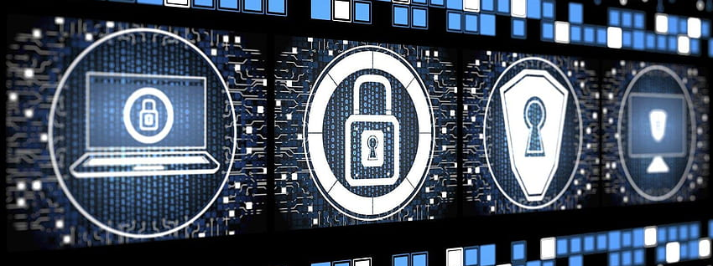
Thank you
Best of Luck!

